Slide 1

Risk Assessment Workbench
GENIUS HACKS Q3 2026e
HumAId Risk Governance
How we applied AI across all six SDLC stages, and where humans stayed in charge
October 2026
Notes:
Team of four: backend/.NET tech lead, application developer, QA, DevOps. The deck follows the six SDLC stages; each stage shows what AI did and what the team decided.

Slide 2
Risk reviews are slow, inconsistent and hard to audit
PROBLEM STATEMENT
A ~$500B national bank must assess every new product, feature, process, vendor, geography and customer segment before go-live.
15–20
2 analysts
Slow
business days per assessment, run on email, Word, Excel and SharePoint
can reach different conclusions on the same change
to reconstruct the reasoning behind a past rating when examiners ask
OUR PRINCIPLE
THREE ROLES
FOUR OUTCOMES
The system prepares, humans decide
Product Owner raises the change
FCRM Analyst assesses, finalizes
Risk Committee votes
Approved
Approved with conditions
Deferred
Rejected
Nothing is auto-approved or auto-rejected
2
Notes:
A ~$500B bank assesses every change before go-live, today over 15–20 business days on email and Office files, with inconsistent outcomes and weak audit trails. Our principle: the system prepares, humans decide. The brief was deliberately incomplete; expanding it was part of the challenge (stage 1).

Slide 3
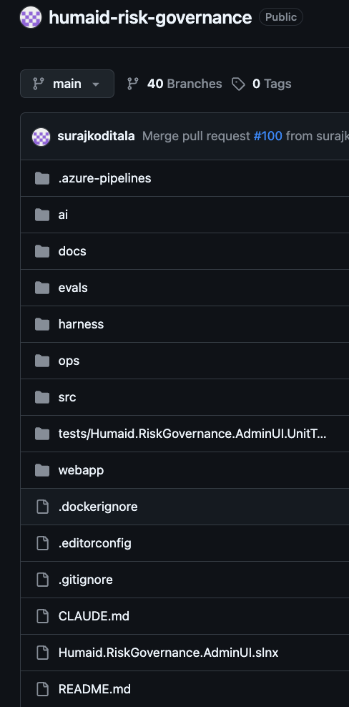
One pattern in every SDLC stage: AI proposes, the team decides
OUR APPROACH
Stage | What AI did
1 Requirements | Researched frameworks and drafted epics
2 Design | Drafted architecture, data model and diagrams
3 Development | Claude Code co-wrote the code; 3 AI features in the product
4 Testing | Generated the e2e suite and filed defects to Boards
5 Deployment | Reviews every pull request in the pipeline
6 Operations | SRE watchdog agent triages live telemetry
AI proposes
→
Team reviews
→
Human decides
→
Decision recorded
3
Notes:
This is the spine of the deck. Every stage follows the same loop: AI proposes, the team reviews, a human decides, the decision is recorded. Co-authored means Claude Code wrote the change and a team member reviewed and committed it.

Slide 4
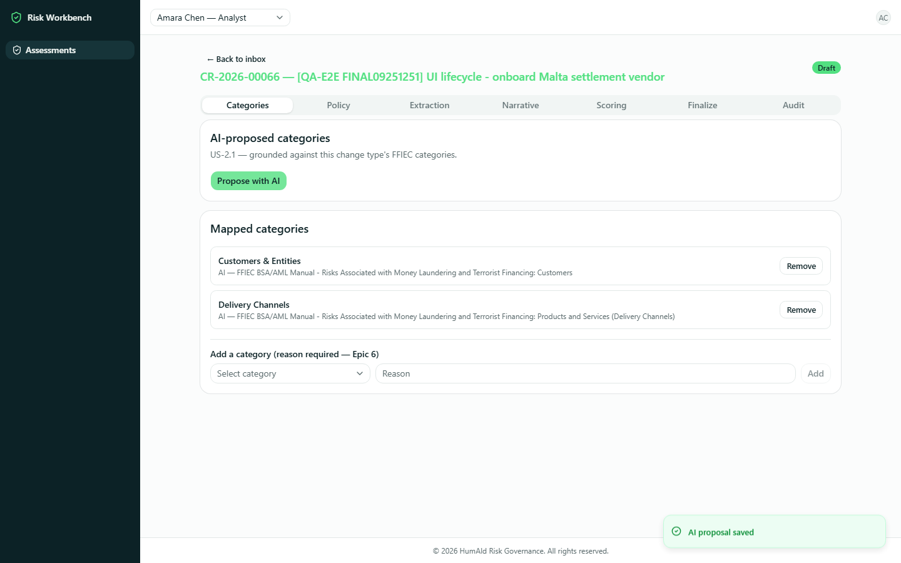
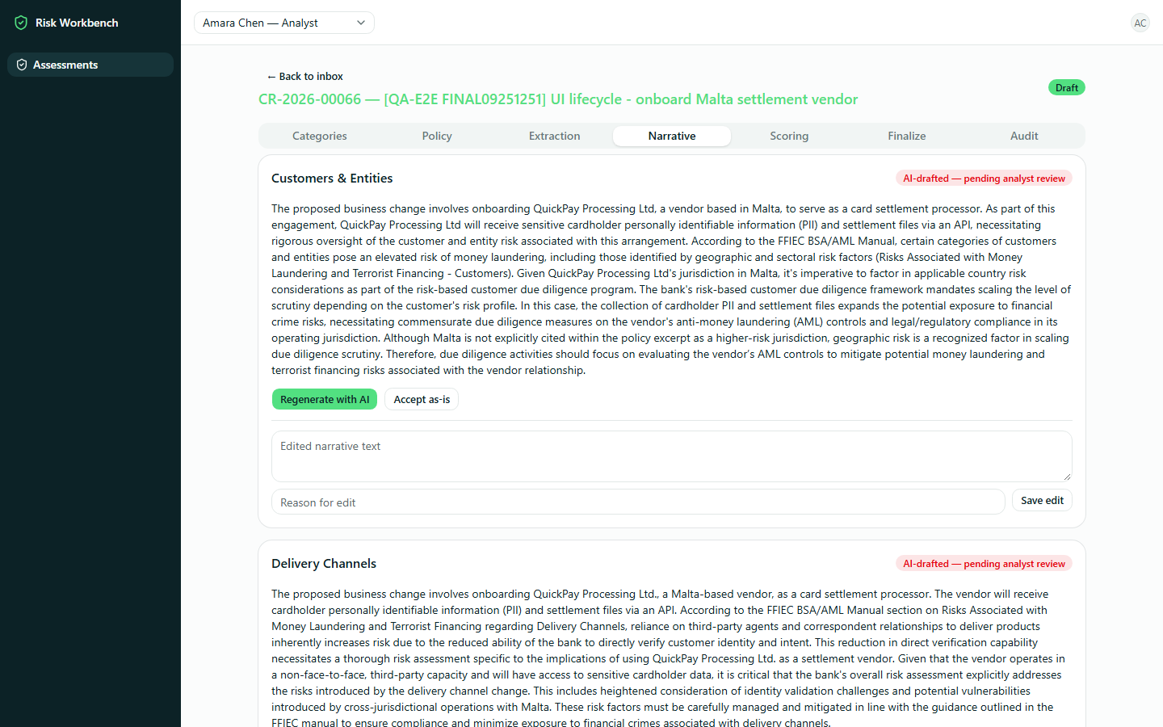
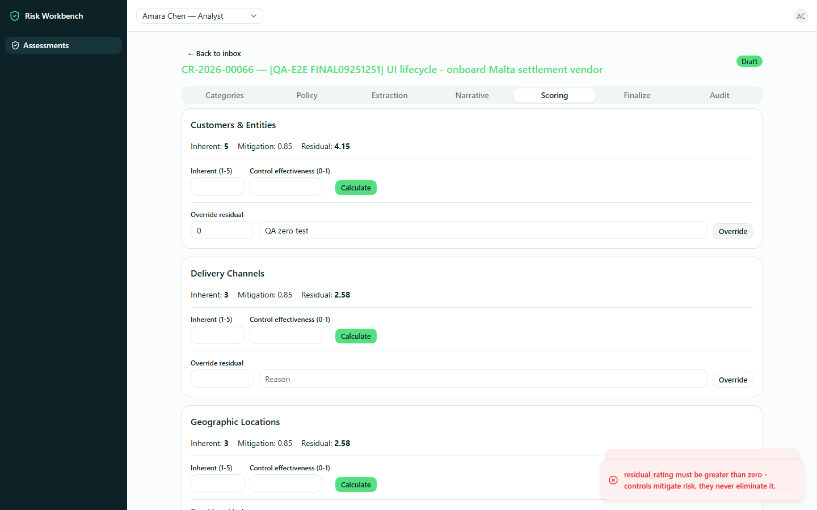
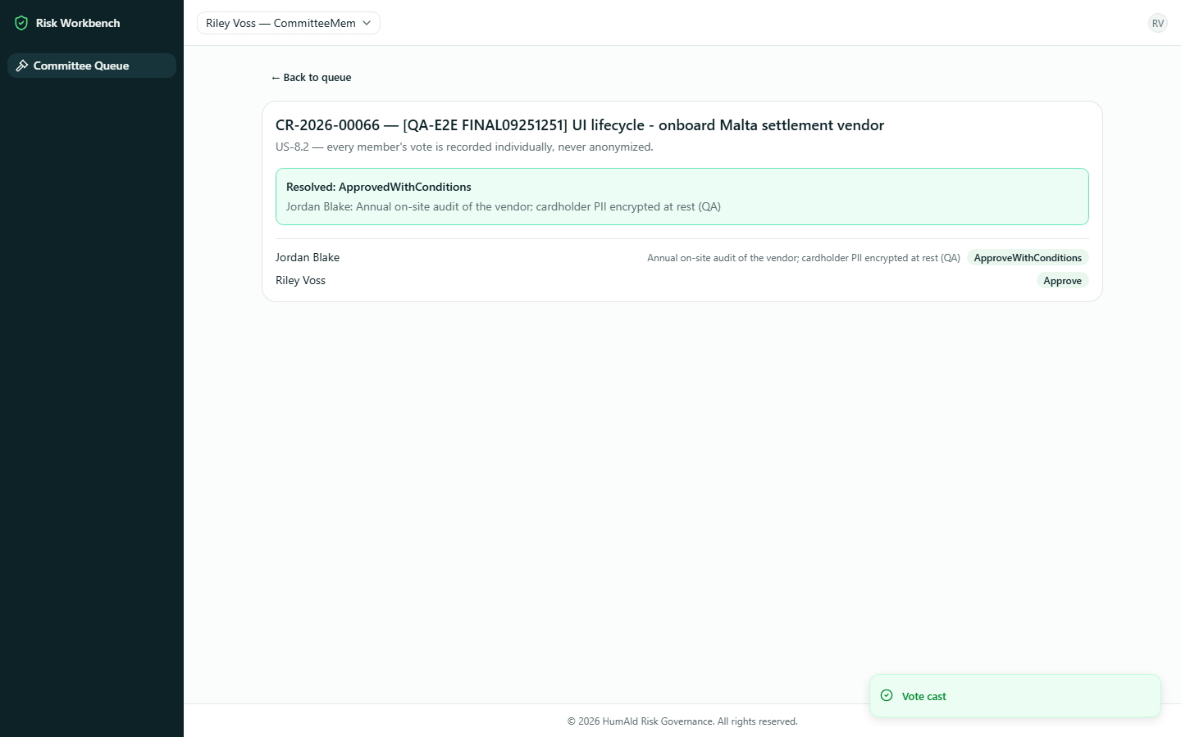
One change request, from AI proposal to committee decision
WORKING DEMONSTRATION
Demo flow
Sign in: each role sees only its screens
Product Owner submits a change with documents
AI maps FFIEC categories; analyst adds or overrides
Policy search: each result relied on or not relevant
AI extracts fields from PDF, Word or Excel
AI drafts narrative; analyst edits with a reason
Deterministic score; analyst finalizes
Committee votes; request locks; audit trail complete
1 AI proposes categories
2 AI drafts the narrative
3 Override needs a reason
4 Decision recorded
4
Notes:
Screenshots are from the QA end-to-end run (25 Sep 2026). Show the live demo or video here. Points to call out: every AI output arrives as a proposal; overrides need a reason and a zero score is refused; the committee decision locks the request and completes the audit trail.

Slide 5
From a vague brief to a citable framework and 20 epics
STAGE 1 · REQUIREMENTS
AI compared three frameworks; the team chose FFIEC
How the backlog grew with every review
Epics | Source of the scope
1–10 | AI-drafted from the brief: intake, AI, scoring, committee, audit
11–13 | QA review (17 Sep): access control, deployment, NFRs
14 | Mock bank systems behind a data-ingestion layer
15–18 | DevOps: Terraform, CI/CD, observability
19 | SLA tracking, added after first build testing
20 | AI orchestration state, LangGraph evaluation
CHOSEN · FFIEC BSA/AML Examination Manual
US supervisory exam manual; its four risk areas (products, customers, geographies, delivery channels) cover every business line. Citable.
NOT CHOSEN · FATF Recommendations
Standard for countries, not banks. FFIEC already uses FATF's high-risk jurisdiction lists.
NOT CHOSEN · Wolfsberg Group guidance
Useful industry practice, but not a framework examiners assess against.
Every AI epic has a matching story for human review and sign-off
5
Notes:
The team brainstormed gaps in the deliberately incomplete brief, then used AI to research and compare candidate frameworks. The team chose FFIEC because it covers every line of business in the brief. Epics were drafted with AI, reviewed and merged by the BA and team, then loaded into Azure Boards. Each later review added scope: QA (11–13), ecosystem (14), DevOps (15–18), SLA tracking (19), orchestration (20). Research prompt: ai/research/.

Slide 6
Only three workflow steps call a model; the rest is deterministic
STAGE 2 · DESIGN AND WORKFLOW
React SPA (Auth0 roles) → .NET API (role checks at the API) → services
CONTEXT MANAGEMENT
Category mapping
Policy search
Document extraction
Narrative drafting
Scoring
Committee vote
Grounded inputs
Each call gets only the allowed FFIEC categories and retrieved policy text
AI
Rules
AI
AI
Rules
Human
Guarded outputs
Category IDs outside the list are dropped; extraction must quote its source
One AI interface, swappable provider
Claude (Anthropic) · Azure AI Foundry fallback · LangGraph engine under evaluation
Honest gaps
Unsupported narrative claims are returned separately, never blended in
PostgreSQL
Stored functions write every change with an audit event
Append-only audit table: trigger blocks UPDATE and DELETE
Local FFIEC policy corpus, full-text indexed
Mock bank systems (separate API)
Synthetic CRM, core banking and vendor data
Snapshot taken at intake through Data Ingestion
Committee decision pushed back, with no AI call
Versioned prompts
Prompts live in /ai/prompts, mirrored from code
Team context
CLAUDE.md and user-stories.md keep every Claude Code session on spec
6
Notes:
The stack was chosen around the connectors available to Claude Code (PostgreSQL and Azure DevOps Boards), so AI could work directly against the schema and the backlog. Only category mapping, document extraction and narrative drafting call a model; policy search, scoring and the committee vote use no tokens. The AI layer sits behind one interface, so the provider can be swapped (Claude, Azure AI Foundry; LangGraph engine under evaluation) without touching the human gates in .NET and PostgreSQL. Prompts are versioned in /ai/prompts. FFIEC is fixed for the MVP; configurable frameworks are an extension point. Engineering judgement: no LLM where a rule or a query gives the same, explainable answer every time.

Slide 7
Claude Code drafts, the harness checks, a person decides
STAGE 3 · DEVELOPMENT HARNESS
Pick a story
Draft with AI
Review the diff
Run the harness
Commit, open PR
Gates, then merge
Claude starts on spec
What the harness checks
How the checks work
WHAT STAYS HUMAN
CLAUDE.md and the user stories load first
Acceptance criteria come from the Azure Boards story
Connectors reach the database schema and the backlog
Prompts and rules are files in /ai and /harness
Architecture: code stays in its layer
Audit: overrides record a reason
Citations: AI output traces to a source
Rules over AI: flags AI calls where a fixed rule would do
Async and config: no blocking calls; missing settings fail loudly
Standards: naming and comments
Harness check runs before every commit
Each check reviews only the changed code, against one rule
Rules are prompt files: tune one without code changes
The developer reads every AI diff before it is committed
The harness reports; it never fixes, commits or merges
The developer owns every line: “the AI wrote it” is no excuse in review
AI commits carry a
Co-Authored-By trailer
Required PR checks pass, then a person merges
Dev Harness: Six parallel checks (architecture, database gate, citation guard, no LLM where unjustified, async and config, coding standards) review each code change before it’s committed.
7
Notes:
1) Pick a story from Azure Boards. 2) Claude Code drafts code and tests, starting from CLAUDE.md and the user stories. 3) The developer reads the diff. 4) Before committing, run python -m dev_harness check: six LangGraph checks run in parallel over the git diff (architecture layers, DB reason and audit event, citation guard, no LLM where a rule works, async and config, coding standards) and return one report; nothing is auto-fixed. 5) Commit with a Co-Authored-By trailer and open a PR. 6) Build, unit tests and security scans are hard gates; the AI code review is read-only; a person merges into release/1.00. Every lane ends at a human.

Slide 8
We tested the AI and the whole app, found failures, and fixed them
STAGE 4 · TESTING AND EVALUATION
AI checks: does each AI feature give the right answer?
QA end-to-end testing
Eval | Cases | Scoring
Category mapping | 5 | Set overlap; nothing outside the list
Document extraction | 4 | Exact match; ambiguity flagged
Narrative drafting | 3 | Heuristic proxy, labelled as such
Guard clauses | 2 | Zero-cost: no model call
120
13
218
e2e test cases
Playwright specs
evidence files
46 of 120 failed on the first run, 25 Sep
31 defects (3 Critical, 10 High, 13 Medium, 5 Low), AI-filed as Bugs #99–127
Re-run after fixes, 28 Sep
Unplanned iteration: SLA tracking (Epic 19) was added after the first build; the 15–20 day cycle had no requirement.
When AI fails: manual analyst path; an AI outage never blocks a pull request.
8
Notes:
Evals call the same production AI clients. Scoring is deterministic wherever the domain allows; the narrative check is openly labelled a heuristic proxy. QA directed Claude Code to generate the e2e suite from the acceptance criteria (prompt logged in ai/qa). First full run (25 Sep): 74 passed, 46 failed; defects filed to Azure Boards as Bugs #99–#127 by an AI-driven script. Example fix: DEF-002 server-side role enforcement; database migrations are named after the defect they fix.

Slide 9
Deployed as code, reviewed by AI, watched by an agent
STAGES 5–6 · DEPLOYMENT AND OPERATIONS
Infrastructure and gates
Where humans overruled AI
SRE watchdog Agent, every 30 min
Reusable Terraform modules
Reverted the auto-merge Claude built
OpenTelemetry → App Insights → 4 KQL signals
Application and Infrastructure PR review agents
Rejected Claude's succeededOrFailed() pipeline condition
Claude classifies: critical, warning or OK
Private endpoints, deny-by-default networking
Managed identities and no secrets in the code
Opens or closes a GitHub issue
Hard gates: TFLint, plan, Trivy, vulnerability check
Corrected Claude's wrong claim about the VNet setup
AI only classifies and summarizes
AI reviewer: read-only JSON verdict as the feedback; only a blocker fails the build
A person decides what to fix
Next: dashboards, runbooks, and reports
Production readiness: Every release is built, Trivy-scanned and deployed to dev by pipeline, then verified end to end. Once stable, the same image is promoted to higher environments with no rebuild, so what was tested is what ships.
9
Notes:
Pipelines run in Azure DevOps against the GitHub repo. Hard gates are not AI: terraform fmt/validate/TFLint/plan, Trivy HIGH and CRITICAL on images and IaC, npm audit and .NET vulnerability check; Checkov and Semgrep are information only. The AI reviewer's rules defend against prompt injection in diffs. Human overrides are recorded in docs/architecture/pipelines-architecture-mapping.md. Operations: both apps register Azure Monitor OpenTelemetry; the watchdog runs four deterministic KQL queries, Claude only classifies and summarises, and the pipeline opens or closes GitHub issues. Next: dashboards, runbooks, diagnostic settings beyond dev (off in dev to control cost).

Slide 10
What we would keep, and what we would do differently
ENGINEERING JUDGEMENT AND LESSONS
✓ Keep
→ Do differently
Deterministic rules for scoring, search and decisions; AI only for language tasks
Log every generation prompt from day one; our epic prompt was not kept
A human gate per AI output, enforced in the database
Measure tokens from the first AI call, not at the end
One context file (CLAUDE.md) so every AI session starts on spec
Close open questions sooner: PO visibility, override sign-off, config approval
Evals that say plainly what they do not verify
The system prepares. Humans decide.
github.com/surajkoditala/humaid-risk-governance
10 · Thank you. Questions?
Notes:
Be candid here: the panel probes decisions rather than features. Close with the principle, then open for questions.

